Slide 1

Analysis on cameras in Flipkart Website

Slide 2
About us
Member-1:
SAGI LAKSHMI ROHITHA
I have recently completed my B.tech in the stream of computer science and engineering. Now I have done my Data Analytics course at INNOMATICS RESEARCH LABS
Member-2:
BELLAM RAJITHA
I have recently completed my B.tech in the stream of Electronics and communication engineering. Now I have done my Data Analytics course at INNOMATICS RESEARCH LABS

Slide 3
Objective
To analyze data and determine the top camera brand based on original price, pixel count, ratings, and camera type within a specified time frame

Slide 4
Webscrapping:
By using Regex Expressions, we performed data scrapping on the flipkart website.
After scrapping We took columns like Brand , Camera , Pixels, Original_price , Discount_price , Discount , Rating , WiFi Connectivity.
Now, we had eight columns,480 rows in the dataframe

Slide 5
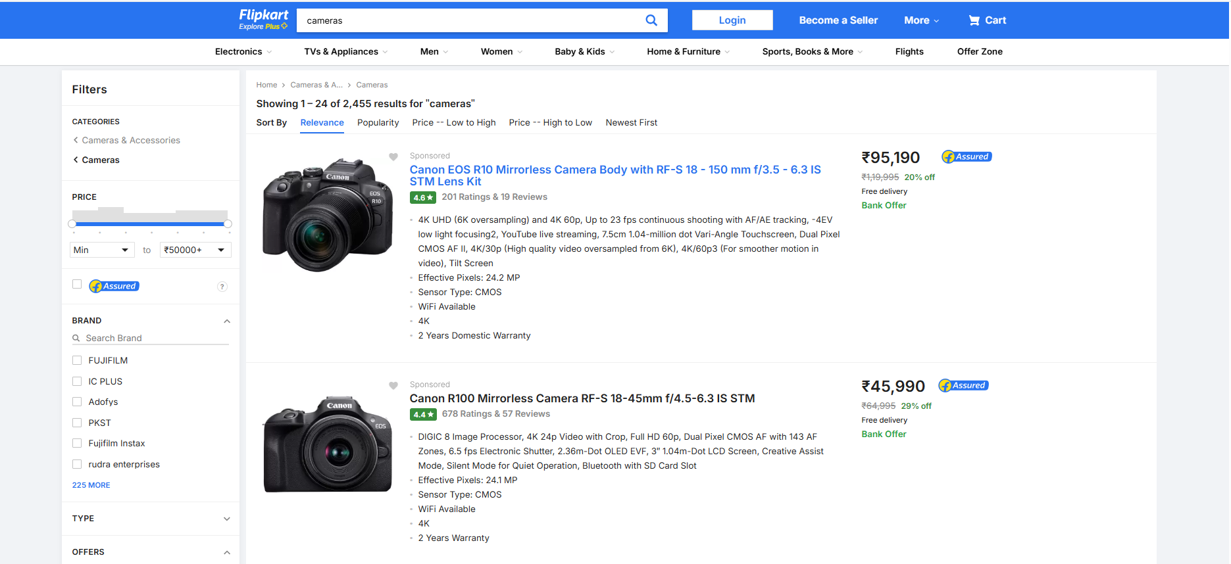
WEBSITE: We performed scrapping on Flipkart website to get the data .

Slide 6
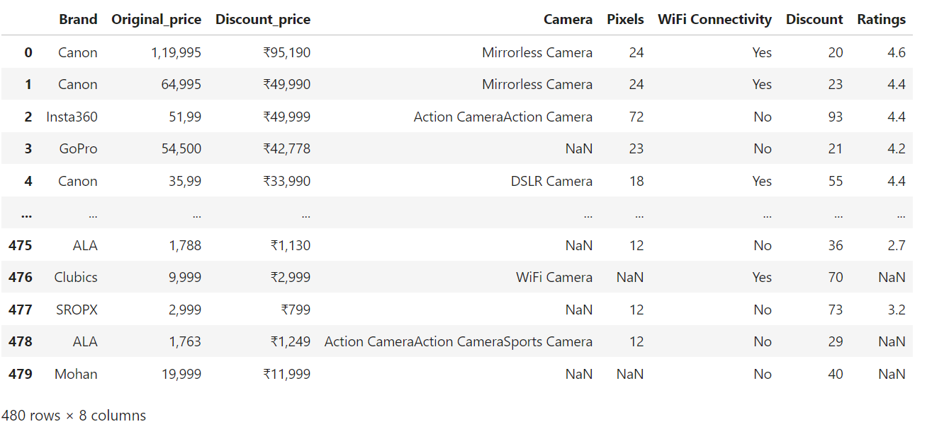
DataFrame:

Slide 7
Data Cleaning:
Data cleaning is the most essential to ensure accuracy and quality in Analysis.
After Successfully importing the data , We started cleaning the data.
We have checked the null values and duplicated values and Unwanted columns.
After checked we started cleaning the data , by dropping the duplicate values and unwanted columns and assigned the NaN values with appropriate values in appropriate columns.

Slide 8
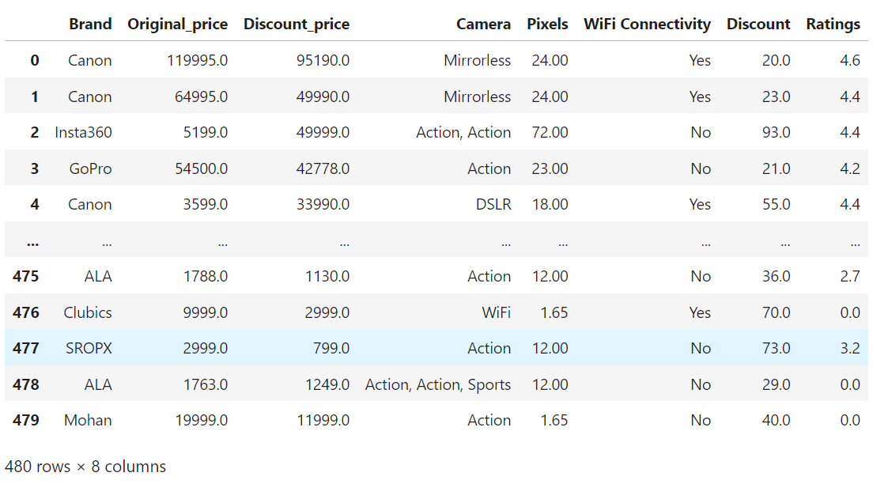
DataFrame after performing data cleaning:

Slide 9
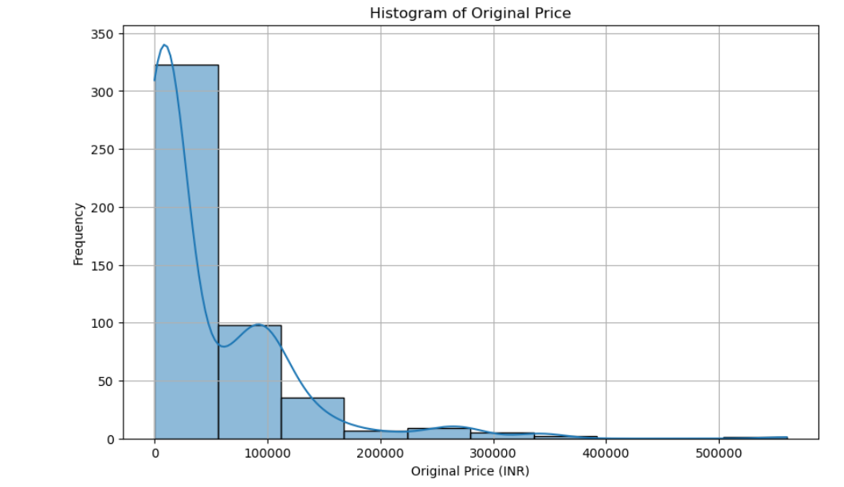
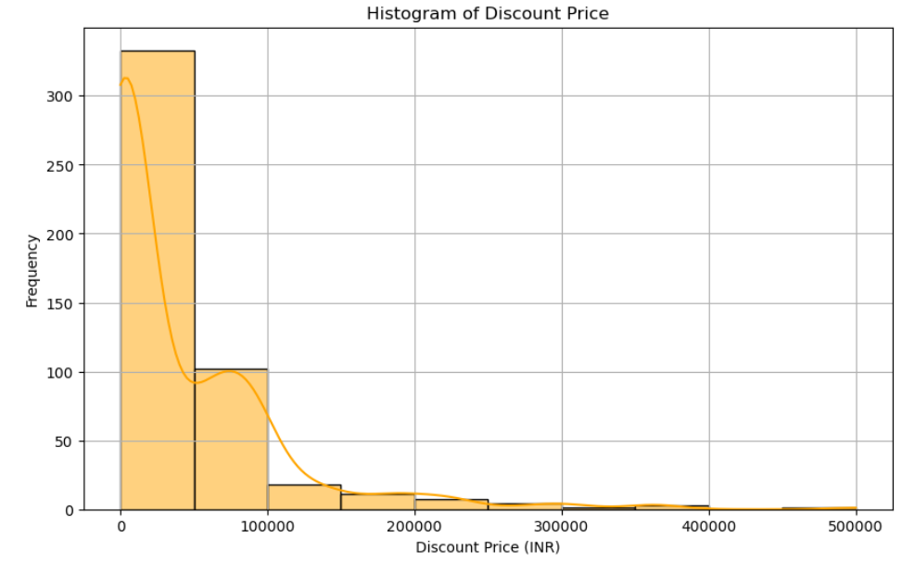
Histogram of original and Discount price
Based on two plots, The frequency range of original prices appears around the lower end of the price range (I .e 100,000 INR)
Based on the plot the frequency sharply decreases , which means there is a higher concentration of lower-priced items

Slide 10
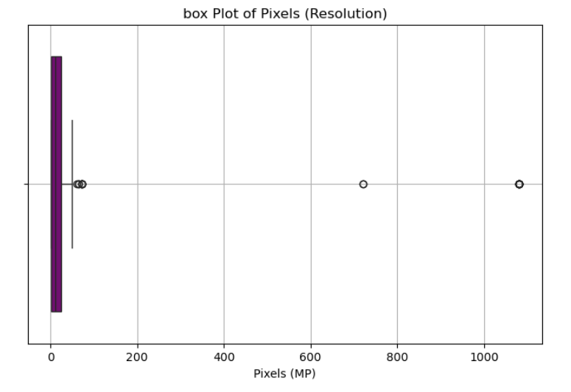
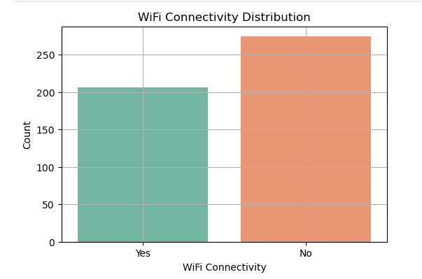
Plotting for Pixels and WiFi Connectivity
Pixels : Most of the data is concentrated near the lower end of the pixel resolution scale , likely below 200 MP , very few outliers are extended upto 1000 MP.
WiFi Connectivity : The bar chart for yes is shorter i.e few of the cameras are having the wifi connectivity.
The bar chart for no is taller i.e most of the cameras are not having the wifi connectivity.

Slide 11
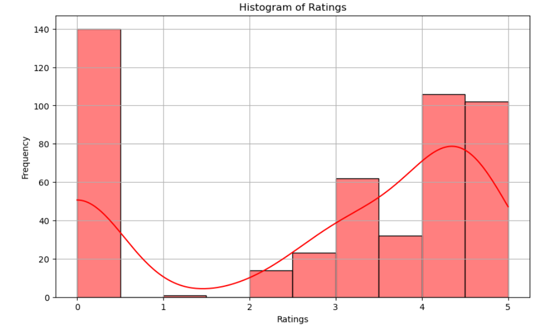
Plotting for Ratings
The distribution apppears bimodal,with peaks at 0 and 4,5. This could suggest a polarization where most of the items either recieve no rating or highly rated.

Slide 12
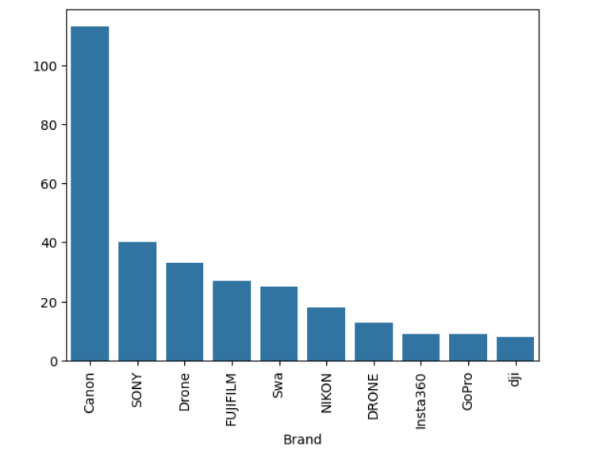
Brands with more Cameras in the Data
This shows the top 10 cameras in the data
Canon , Fujifilm , Sony , Mugo , Drone these are the top 5 cameras based on sales in the data
There is a noticeable gap between Canon and the other brands, suggesting Canon’s value is significantly higher.

Slide 13
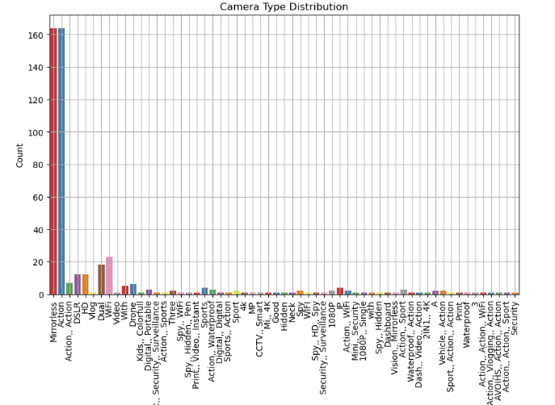
Cameras type distribution
The first two bars (green and red) are significantly taller than the others, indicating much higher values for these categories.

Slide 14
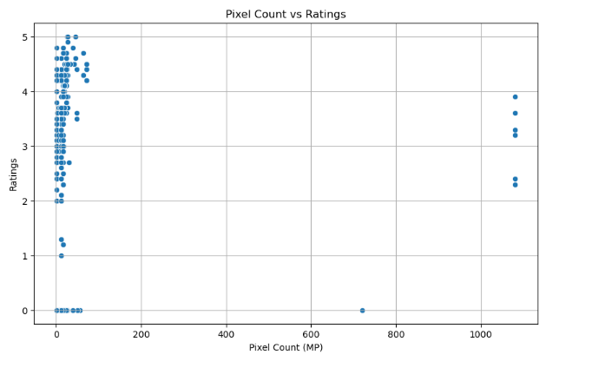
Pixels vs Ratings
Most data points are clustered at the lower end of the pixel count (near 0-200 MP) with high ratings (around 4-5).

Slide 15
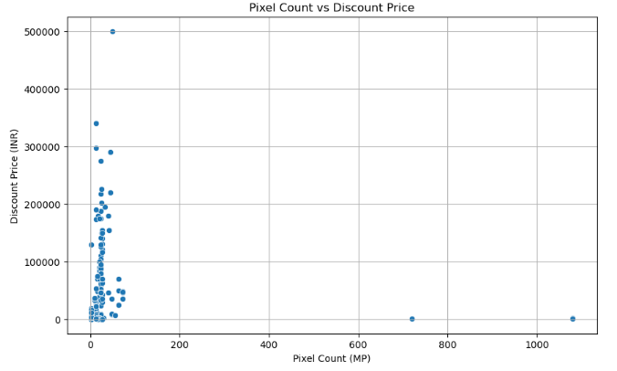
Pixels vs Discount Price
The majority of cameras with higher pixel counts do not necessarily have proportionally higher discount prices

Slide 16
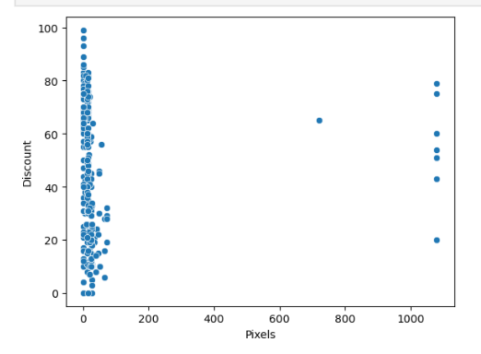
Pixels vs Discount
Most data points are concentrated at the lower end of the ‘Pixels’ axis, indicating that lower pixel counts are more common.
The data points spread out more along the ‘Discount’ axis, suggesting a wider range of discount percentages.
There are a few data points with higher pixel counts and varying discounts, but they are sparse compared to the main cluster.

Slide 17
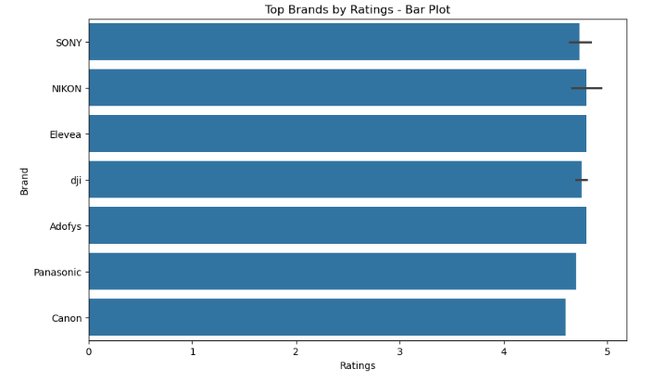
Top brand based on ratings
Nikon , Elevea , Adofys are having highest Ratings

Slide 18
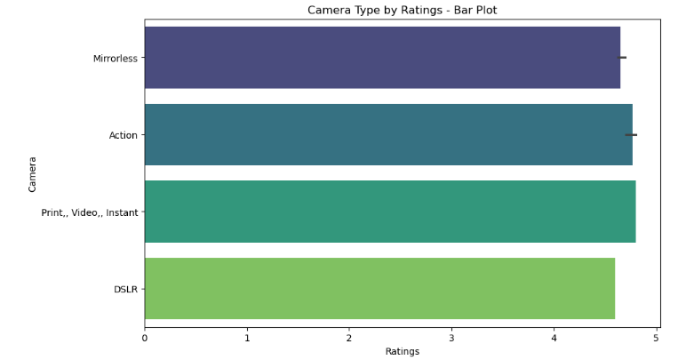
Top camera type by Ratings
Print , video , Instant cameras has the highest rating

Slide 19
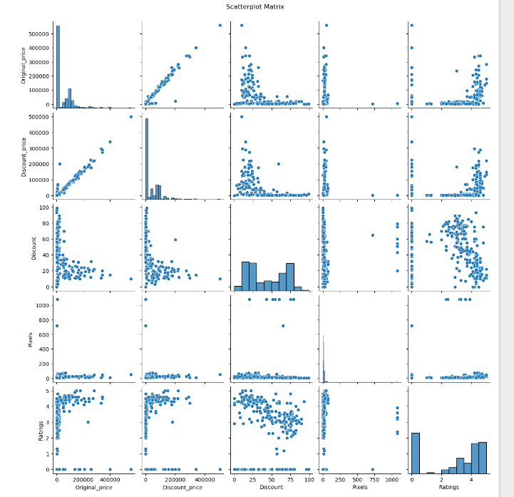
Pairplot

Slide 20
Conclusion:
from the above data, we conclude that first we have done web scrapping and also web cleaning.
At next we have started plotting i.e we starts with an univariate plotting.In univariate plotting .next we have done bivariate analysis In that we have done the relation between 1.pixel count vs ratings 2.pixel count vs Discount price 3.pixel vs Discount 4.Brand vs Ratings 5.camera vs ratings there by each analysis we found how it relates to each other column.At last we have done multi variate analysis on all the numeric columns.
Based on Ratings, Nikon , Elevea , Adofys are having highest Ratings.
The top most camera type that most of users prefers instant camera.

Slide 21

THANK YOU

